Slide 1
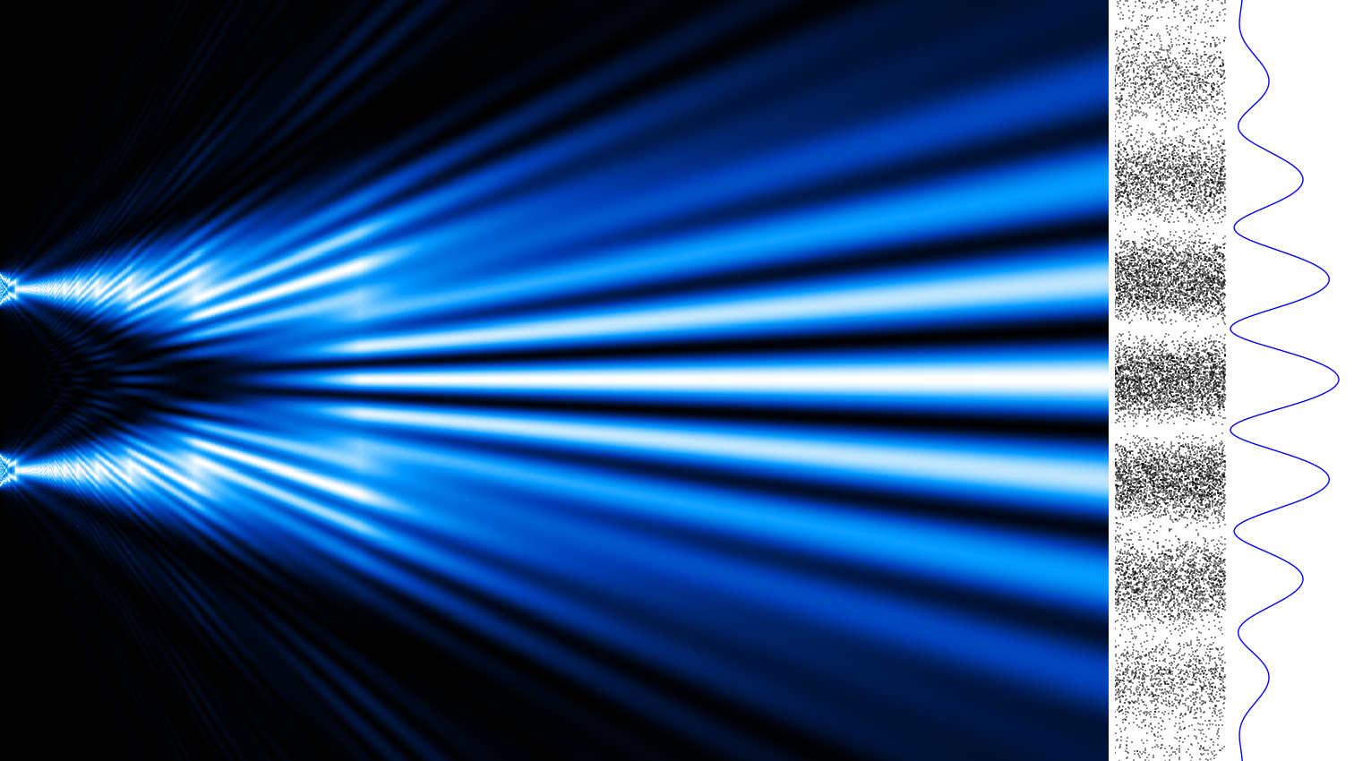
The Quantum Measurement Problem
Mohammed Alsadah

Slide 2
Outline
Motivation.
Wavefunction collapse and characteristics of QM.
The measurement problem.
EPR paradox.
Local hidden Variable theories and Bell’s inequality.

Slide 3
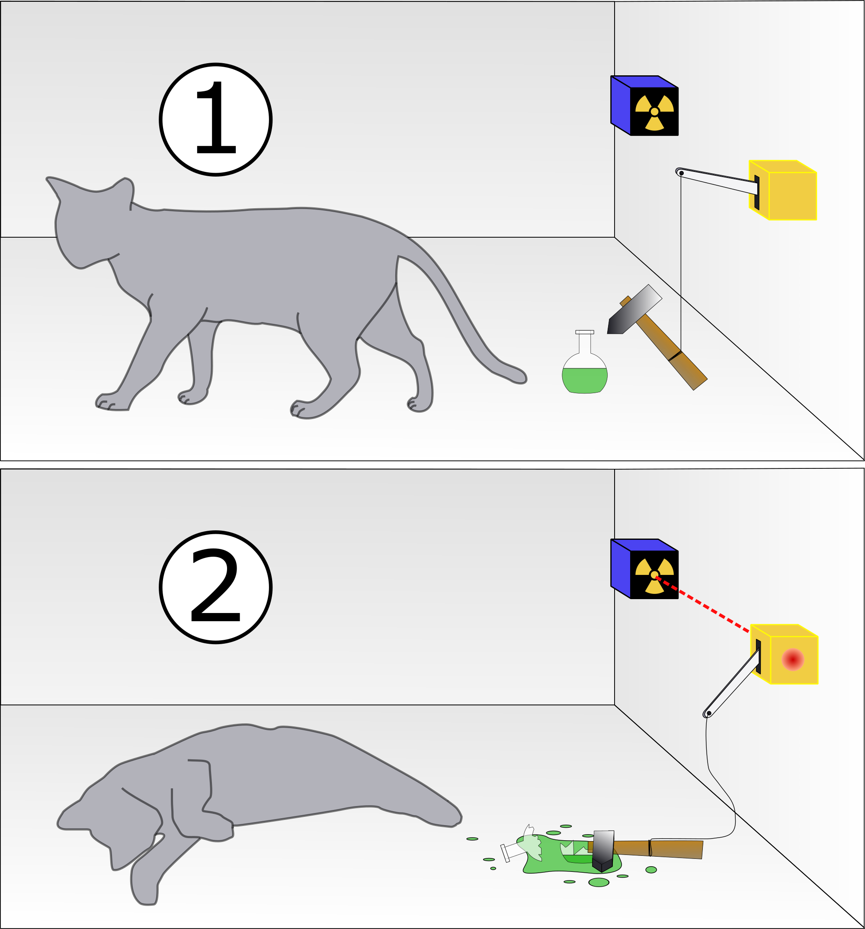
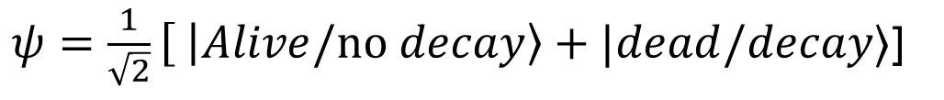
Do We Understand Quantum Mechanics?
Consider this system with two states: A Geiger counter connected to a trigger that releases a hammer upon particle decay. The state of the cat is either dead or alive:
$ψ=\frac{1}{\sqrt{2}}\left[ | Alive/no decay\right\rangle +|dead/decay⟩$]

Slide 4
The Collapse of The Wavefunction
Quantum mechanics predicts many possibilities or outcomes for an experiment.
All these possibilities disappear when the system is observed, and the possibilities collapse into a spike.
Measurements in quantum mechanics disturb the system.

Slide 5
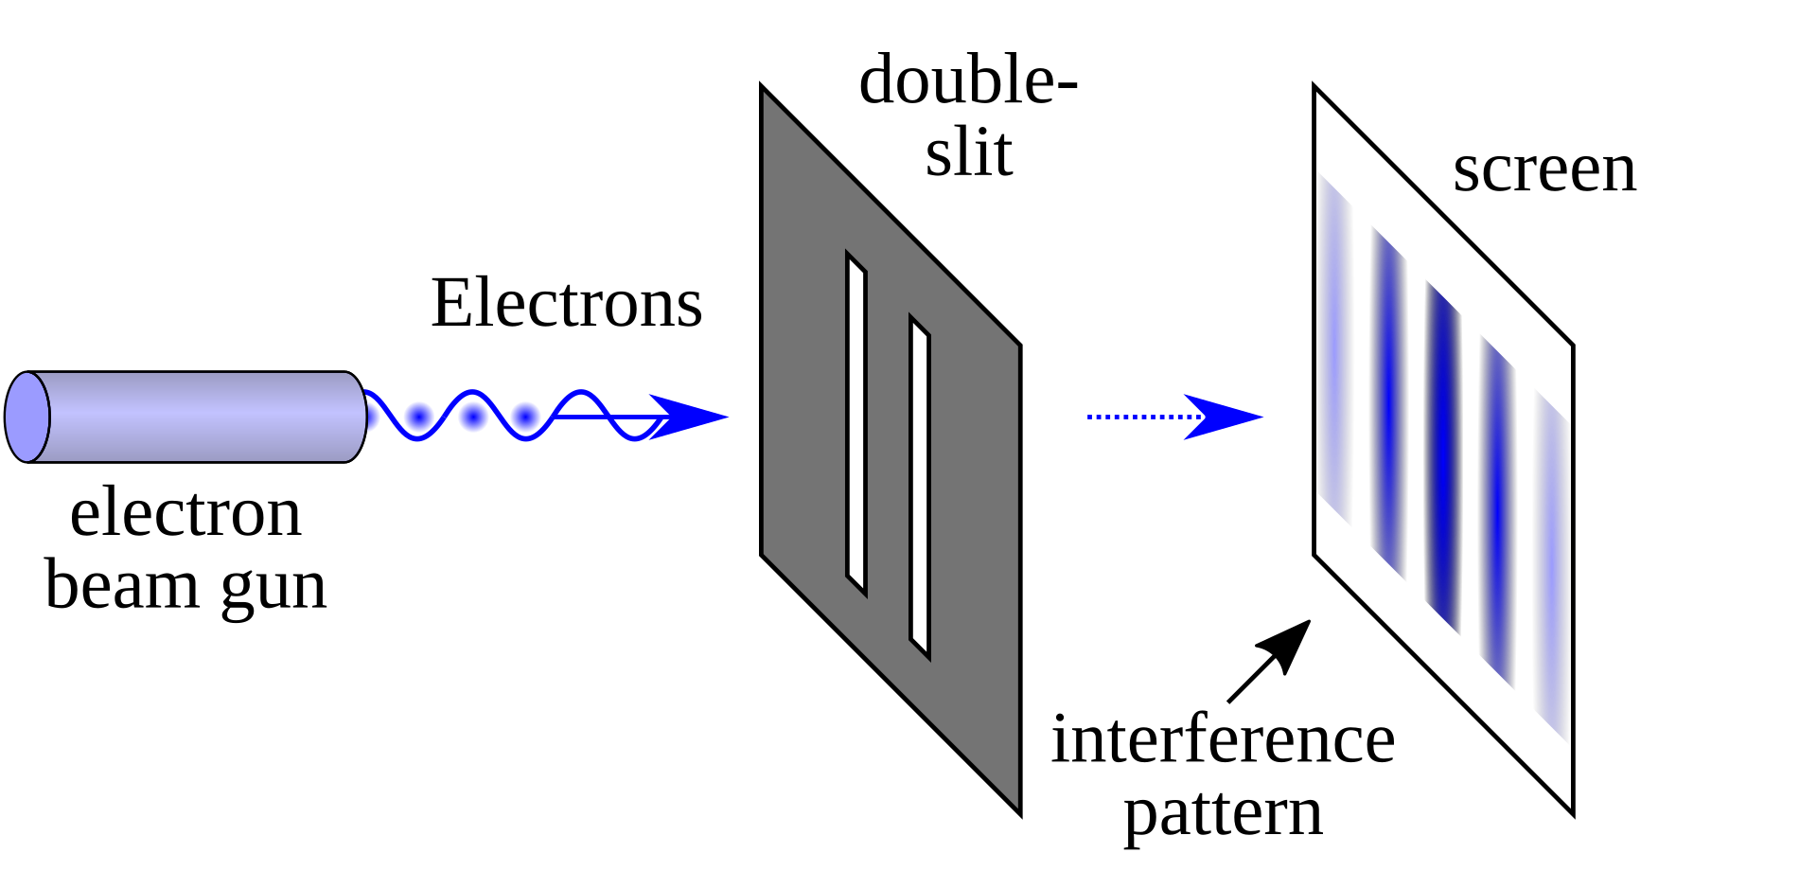
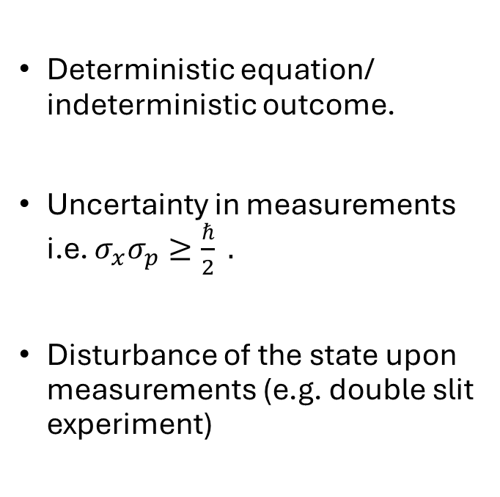
Characteristics of Quantum mechanics
Deterministic equation/ indeterministic outcome.
Uncertainty in measurements i.e. $σ_{x}σ_{p}≥\frac{ℏ}{2} .$
Disturbance of the state upon measurements (e.g. double slit experiment)

Slide 6
What is a Measurement?
In the classical sense, a measurement is the process by which an interaction between the measuring device and the measured system reveals a pre-existing property about the system.
Quantum mechanics, challenges this definition since we cannot say anything about the system until we measure it.
The quantum measurement problem: is the problem of having a system with many possibilities to be in but at the point of measurement we get only one (random) outcome.

Slide 7
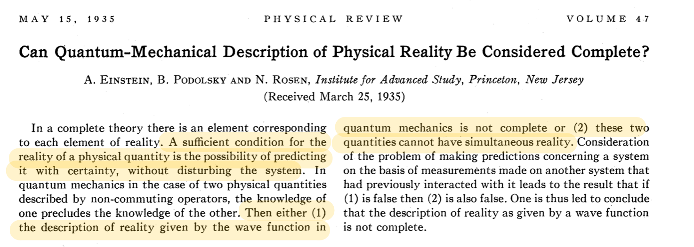
Incomplete Theory: The EPR Paradox
Could it be just a lack of knowledge?

Slide 8




The EPR Paradox (Bohm’s variant)
Consider the decay of pion into an electron and positron:
$$π^{0}→e^{+}+e^{−}$$
From spin conservation, their state is
$$ψ=\frac{1}{\sqrt{2}}\left(\left|↑↓\right\rangle −\left|↓↑\right\rangle \right)$$
$$e^{−}$$
$$e^{+}$$
$$π^{0}$$

Slide 9
The EPR Paradox
This system is an entangled system.
Quantum mechanics can only tell that the spins are correlated (i.e. if one is up the other is down).
Upon measurement of the electron, the wavefunction collapses instantaneously, revealing the spin of the positron without measurement.
Since we can know something about the system without measuring it, therefore quantum mechanics is incomplete.

Slide 10
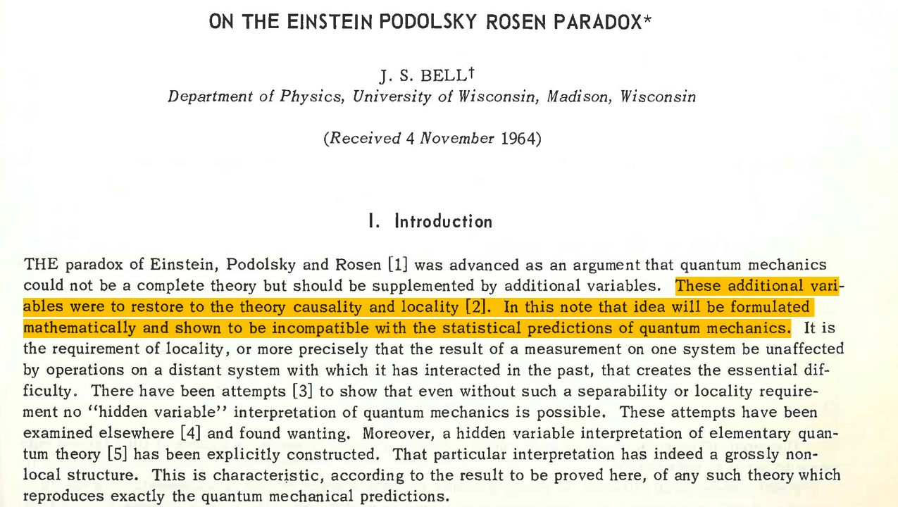
Local Hidden Variables and Bell’s Inequality

Slide 11
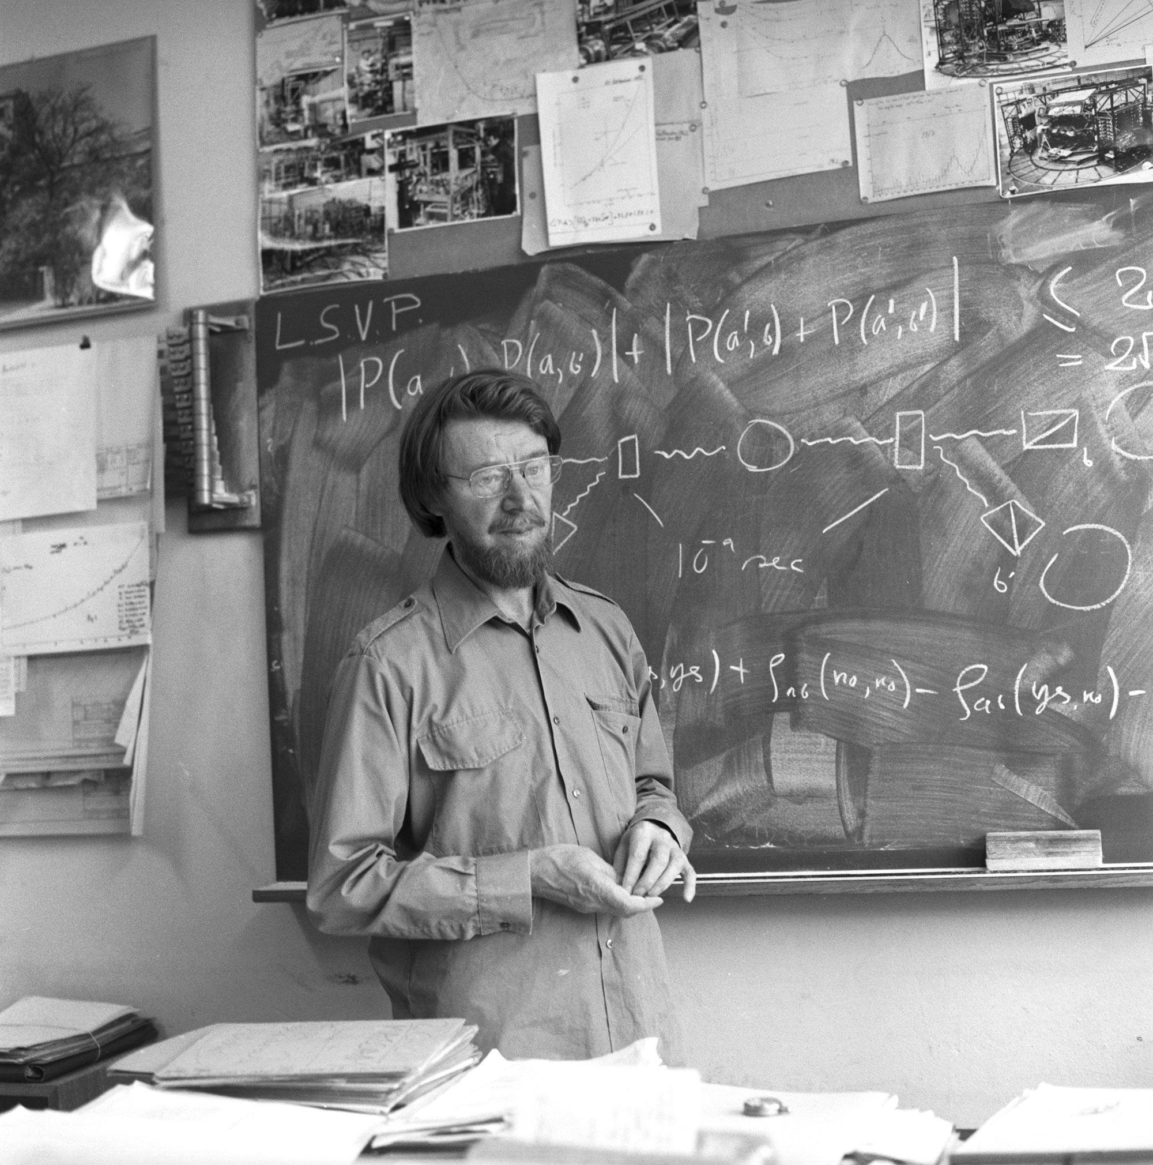





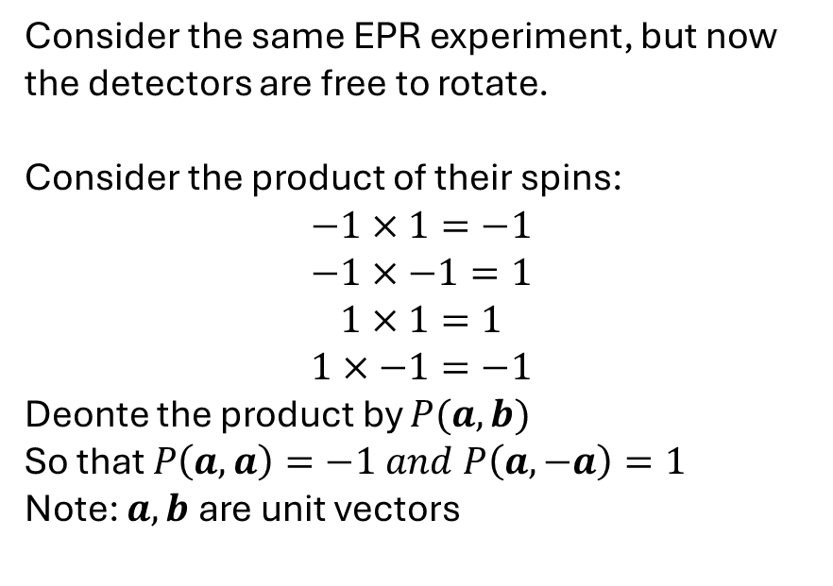
Bell’s Inequality
Consider the same EPR experiment, but now the detectors are free to rotate.
Consider the product of their spins:
$$−1×1=−1$$
$$−1×−1=1$$
$$1×1=1$$
$$1×−1=−1$$
Deonte the product by $P(a,b)$
So that $P\left(a,a\right)=−1 and P\left(a,−a\right)=1$
Note: $a,b$ are unit vectors
$$a$$
$$b$$
$$e^{−}$$
$$e^{+}$$
John Stewart Bell, CERN 1982
$$π^{0}$$

Slide 12
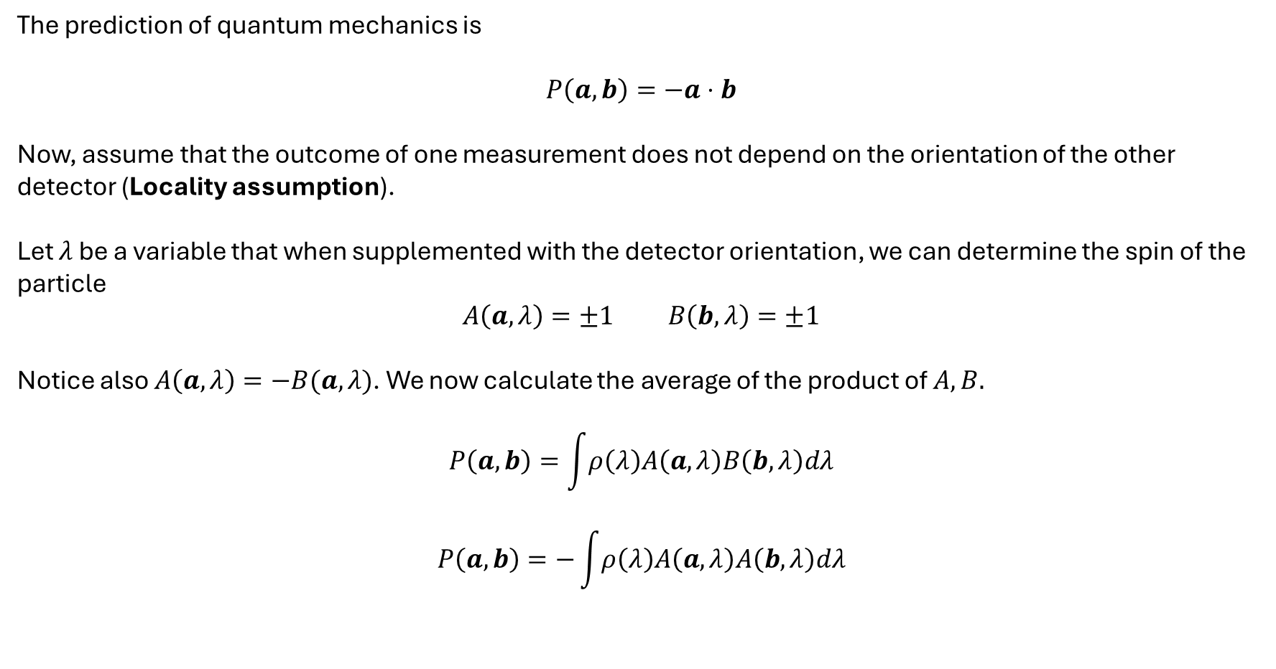
Bell’s Inequality
The prediction of quantum mechanics is
$$P\left(a,b\right)=−a⋅b$$
Now, assume that the outcome of one measurement does not depend on the orientation of the other detector (Locality assumption).
Let $λ$ be a variable that when supplemented with the detector orientation, we can determine the spin of the particle
$$A\left(a,λ\right)=±1 B\left(b,λ\right)=±1$$
Notice also $A\left(a,λ\right)=−B(a,λ)$. We now calculate the average of the product of $A,B.$
$$P\left(a,b\right)=\int{ρ\left(λ\right)A\left(a,λ\right)B\left(b,λ\right)dλ}$$
$$P\left(a,b\right)=−\int{ρ\left(λ\right)A\left(a,λ\right)A\left(b,λ\right)dλ}$$

Slide 13
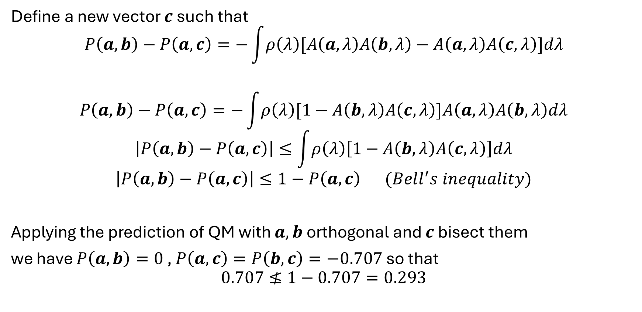
Bell’s Inequality
Define a new vector $c$ such that
$$P\left(a,b\right)−P\left(a,c\right)=−\int{ρ\left(λ\right)[A\left(a,λ\right)A\left(b,λ\right)−A\left(a,λ\right)A\left(c,λ\right)]dλ}$$
$$P\left(a,b\right)−P\left(a,c\right)=−\int{ρ\left(λ\right)[1−A\left(b,λ\right)A\left(c,λ\right)]A\left(a,λ\right)A\left(b,λ\right)dλ}$$
$$\left|P\left(a,b\right)−P\left(a,c\right)\right|≤\int{ρ\left(λ\right)\left[1−A\left(b,λ\right)A\left(c,λ\right)\right]dλ}$$
$$\left|P\left(a,b\right)−P\left(a,c\right)\right|≤1−P\left(a,c\right) (Bell^{′}s inequality)$$
Applying the prediction of QM with $a,b$ orthogonal and $c$ bisect them
we have $P\left(a,b\right)=0$ , $P\left(a,c\right)=P\left(b,c\right)=−0.707$ so that
$$0.707≰1−0.707=0.293$$

Slide 14
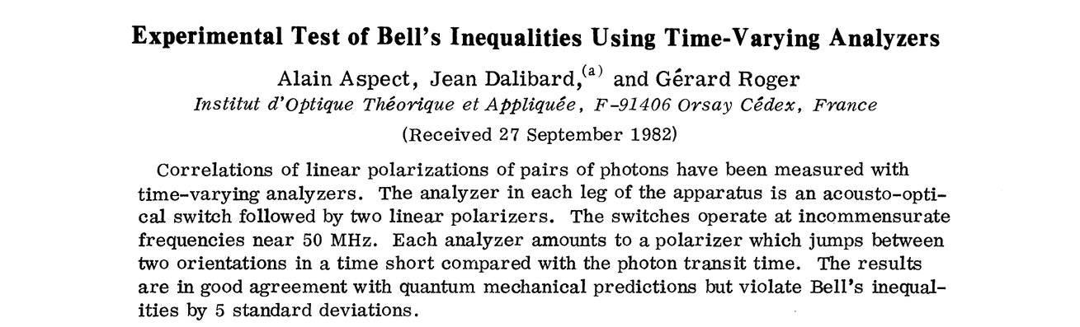
Experiments

Slide 15
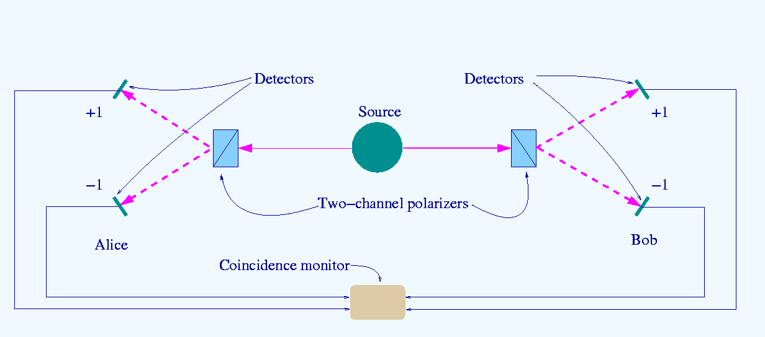

Slide 16

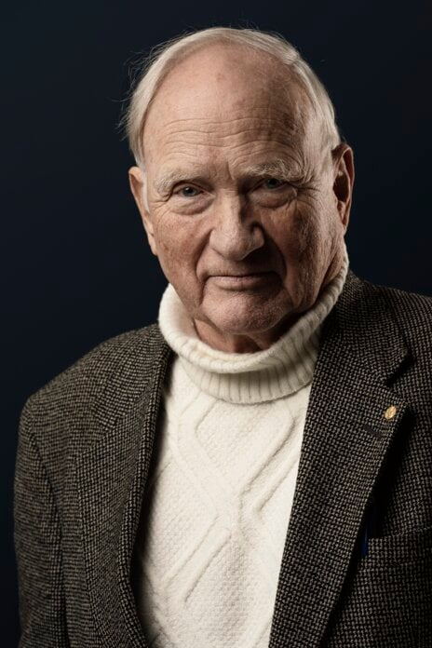

Nobel Prize 2022
The Nobel Prize in Physics 2022 was awarded jointly to Alain Aspect, John F. Clauser and Anton Zeilinger "for experiments with entangled photons, establishing the violation of Bell inequalities and pioneering quantum information science"

Slide 17
Conclusion
The measurement problem is the discrepancy between the quantum mechanical description and the abrupt wavefunction collapse.
EPR paradox Conclude that quantum mechanics is not a complete theory
Hidden variable theories are not compatible with quantum mechanics.

